Slide 1
Work Organization Methods and Schemes
by
Paweł Kowalik
Adam Bartosiak

Slide 2
WBS – Work Breakdown Structure
Exhaustive, hierarchical(general➔specific) tree structure of deliverables and tasks
Identification of terminal elements – basis for project planning
Relates the work scope elements to each other and to the end product(s)
A $1,000,000,000 project is simply a lot of $10,000 projects joined together. The WBS is used to provide a framework for this process.

Slide 3
WBS
WBS design should try to achieve certain goals:
Be compatible with how the work will be done and how costs and schedules will be managed,
Give visibility to important or risky work efforts,
Allow mapping of requirements, plans, testing, and deliverables,
Foster clear ownership by managers and task leaders,
Provide data for performance measurement and historical databases, and
Make sense to the workers and accountants.

Slide 4
WBS – stating the obvious
Prepare materials
  Buy paint
  Buy a ladder
  Buy brushes/rollers
  Buy wallpaper remover
Prepare room
  Remove old wallpaper
  Remove detachable decorations
  Cover floor with old newspapers
  Cover electrical outlets/switches with tape
  Cover furniture with sheets
Paint the room
Clean up the room
  Dispose or store left over paint
  Clean brushes/rollers
  Dispose of old newspapers
  Remove covers
A WBS approach for painting a room

Slide 5
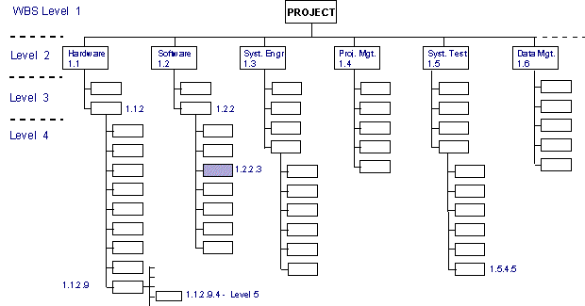

Slide 6
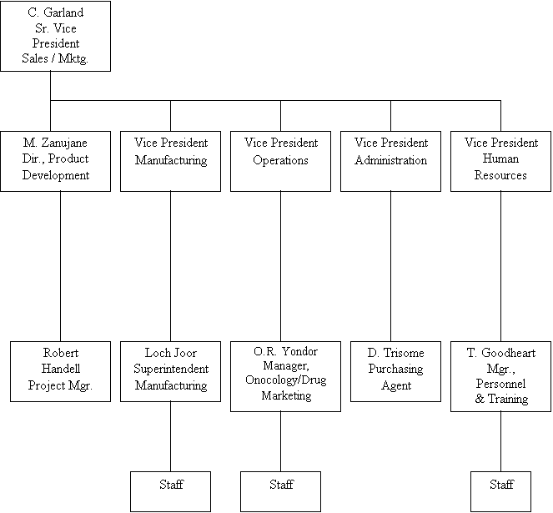
OBS – Organizational Breakdown Structure
Each task in the WBS must be assigned to a committee or person
Mirroring the structure of WBS
Major level tasks to high positioned committe, low level to groups or person within those committees.

Slide 7
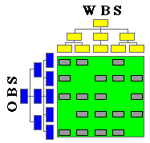
RAM – Responsibility Assignment Matrix
RAM is developed by integrating the Organization Breakdown Structure (OBS) with the Contract Work Breakdown Structure (CWBS).
Home for each work statement of the contract
Providing a disciplined framework

Slide 8
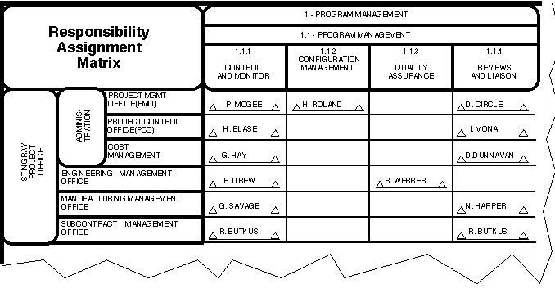

Slide 9
Gantt Charts
Gantt charts are useful tools for planning and scheduling projects.
  Gantt charts allow you to assess how long a project should take.
  Gantt charts lay out the order in which tasks need to be carried out.
  Gantt charts help manage the dependencies between tasks.
  Gantt charts determine the resources needed.

Slide 10
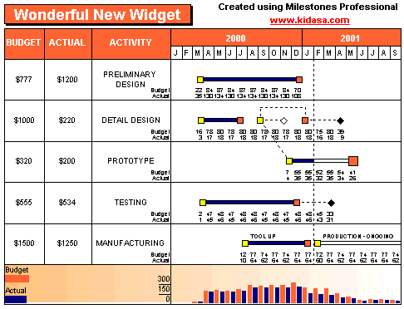
Gantt Charts continued
Gantt charts are useful tools when a project is under way.
  Gantt charts monitor progress. You can immediately see what should have been achieved at a point in time.
  Gantt charts allow you to see how remedial action may bring the project back on course.

Slide 11
PERT Charts
PERT stands for Program Evaluation Review Technique
Project management tool used to schedule, organize, and coordinate tasks within a project
Graphic illustration of a project as a network diagram consisting of:
  Numbered nodes – events
  Labelled vectors - tasks

Slide 12
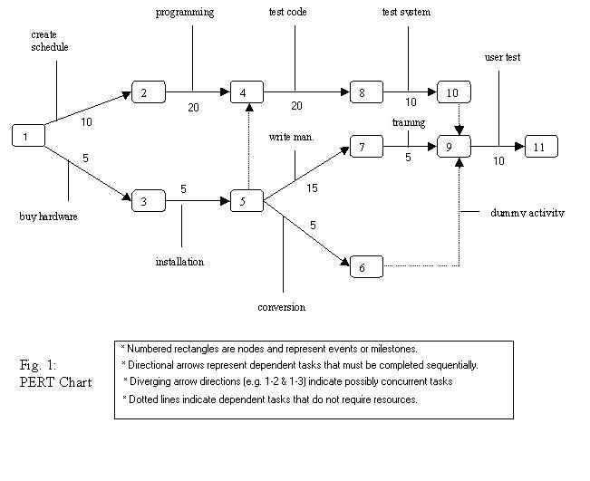
PERT Charts continued
PERT preferred over Gantt Charts because of task dependencies illustration
PERT Charts may sometimes be troublesome to interpret in reference to larger systems

